Slide 1

Textiles and Fire Safety
Presented by: Brad Davies
On-Site Drapery Cleaners
Notes:
Welcome everyone, thanks to the CITT for inviting me to speak today.
I am Brad Davies, Owner of On-Site Service. I am here today because there is a lot of misunderstanding regarding draperies and the fire code, it is often overlooked. I hope to shed some light on that for you today. We know there is a focus on Long Term Care right now from the OFM.
Objective: Objective is for you to leave this presentation with the practical knowledge you require to assess the safety risks associated with stage draperies.

Slide 2
Objectives
What does the Fire Code Require?
WHAT, WHEN, WHICH TEST & WHERE
Flame Retardant Treatments: Background, Composition, Effectiveness
Best Practices on Care of Maintenance of Drapery

Slide 3
The Risks
All Drapes are naturally flammable. Represent large quantity of combustible material.
In the past, there have been terrible disasters related to fires in assembled occupancies such as theatres
  In fact, the most deadliest theatre fire on record, Iroquois Theatre in Chicago was caused by an arc light which ignited the curtains. 602 people died.
  1942 Cocoanut Grove fire in Boston, Massachusetts (492 fatalities)
On theatre stages, the presence of hot lights, props and electrical sparks significantly increases the risk of fire.
  Recent Fires on Stages include Sheridan College, Public Schools in Burlington, Brampton and Kingston.
In response, we have developed safety standards and codes to prevent this type of disaster from ever happening again. So…we fixed it right?

Slide 4
What has been done to prevent this?
And then, it happened again.
  Station Nightclub 2003, Rhode Island- 100 fatalities
  Boate Kiss Nighclub in Brazil- 240 fatalities
Problem is not the standard or the code, problem is, it not being followed.
Enforcement: Has historically been under the jurisdiction of the Fire Department, however, recently the Ontario Ministry of Labour has targeted the theatres and has become actively involved in enforcement of safety standards in theatres.
Notes:
They recently published “Scenery Safety Guidelines for the Live Performance Industry”

Slide 5
  Review of Ontario Fire Code Sub Section 2.3.2.1 and 2.3.2.2 Textile Flammability
Subsection 2.3.2. Textile Flammability
  Flame resistance of textiles
  2.3.2.1.
      (1) Drapes, curtains, netting, and other similar or decorative materials, including textiles and films used in buildings, shall meet the requirements of CAN/ULC-S109, “Flame Tests of Flame-Resistant Fabrics and Films”, when these materials are used in any
        (a) care and treatment occupancy and detention occupancy,
        (b) lobby or exit,
        (c) access to exit in assembly occupancies, and assembly occupancies with an occupant load of more than 100 persons, or
        (d) open floor area in a business and personal services occupancy, mercantile occupancy or industrial occupancy exceeding 1500 m2, except when the floor area is divided into fire compartments not exceeding 1500 m2 in area and separated from the remainder of the floor area by a fire separation having a 1 h fire-resistance rating.
      (2) Existing drapes, curtains, netting, and other similar or decorative materials, including textiles and films used in buildings which meet the requirements for a high degree of flame resistance as described in NOTE 4 of Test Method 27.1 of CAN2-4.2, “Textile Test Methods” are deemed to be in compliance with Sentence (1).
      (3) For the purposes of Sentence (2), “existing” means in place on November 21, 2007.
  Flameproofing treatments
  2.3.2.2.
      Flame retardant treatments shall be renewed as often as required to ensure that the material will pass the match flame test in NFPA 705, “Recommended Practice for a Field Flame Test for Textiles and Films”.
Notes:
This is complicated, let me simplify it into: WHAT, WHERE, and WHICH TEST.
WHAT- Drapes, curtains, decorative materials- includes banners, flags, quilts & mosaics.
WHICH TEST-
WHERE
Existed prior to 2007: NOTE 4 of Test Method 27.1 of CAN2-4.2 (Which does not exist in 2-4.2)
New Builds- Specs for new schools- CAN/ULC S109. Architects & Engineers
On-Going Maintenance- Must be renewed such that they pass NFPA 705

Slide 6
WHAT?
Drapes, curtains, netting, and other similar or decorative materials, including textiles and films used in buildings.
Includes: Drapes, Soccer Nets, Banners, Quilts, Fabric Wall Panels.

Slide 7
WHEN?
Existing Drapes: Ontario Fire Code and NFPA advises that flame proofing treatments shall be renewed as often as required to pass NFPA 705
Typically, all draperies require servicing at least every five years to maintain their flame retardant properties and warrantee. IFR drapery can be cleaned only to remove combustible dust, FR drapery requires cleaning and re-application of flame retardant.

Slide 8
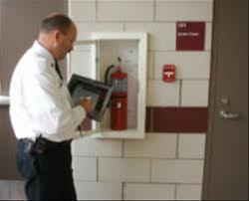
WHICH TEST?
New Drapes: CAN/ULC S-109 Certification Required
Existing Drapes: Fire Code requires flame proofing treatments shall be renewed as often as required to pass NFPA 705
Notes:
Wake up- if you pay attention to any slides- this is the one ! I understand code and standards aren’t the most entertaining of subjects.
Can/ULC S-109- Not 701, not 2.4.2, it is s-109 you are looking for.
We will do a demonstration of NFPA 705 out in the bay after this presentation.

Slide 9
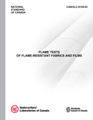
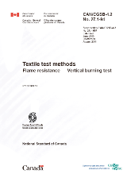
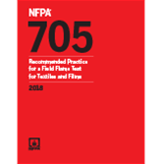
Overview of the tests mentioned in the Ontario Fire Code:
CAN/ULC S-109: “Flame Tests of Flame-Resistant Fabric and Films”
  Measures flash, after flame, flaming drips, char length, tearing loads.
    Small Scale:
      10 samples, 9 by 25 cm- 5 lengthwise, 5 widthwise
      12 seconds flame exposure
    Large Scale:
      10 samples 4 samples of folded , 62.5 by 210 cm
      120 seconds of flame exposure
NOTE 4 of Test Method 27.1 of CAN2-4.2, “Textile Test Methods- Flame Resistance – Vertical Burning Test”
  6 Pieces fabric, 7.5 by 30 cm in size
  12 second flame exposure
  Measures flash, after flame, flaming drips, damage to fabric fibres.
NFPA 705 “Recommended Practice for the Field Flame Test for Textiles and Films”
  1 piece of fabric, 1.27 by 10.16 cm in size
  12 seconds of flame exposure
  Measures flash, after flame, flaming drips. Fails if flashes, burns for 2 seconds or more, or has any drips which continue to burn.
Previously known as NFPA 701 Small Scale
Good to Test Existing Drapery as it is non-destructive testing.
Notes:
First two are typically conducted in a lab by the manufacturer, more rigorous than NFPA 705. These tests prove that the materials meet the standard for high degree of flame resistance when they were manufactured. Due to the amount of material required, up to a square metre of fabric, this testing is considered destructive.
Code says that in 2.3.2 that all drapes must be renewed such that they pass NFPA 705 which is not destructive.
This is important because drapery flameproofing treatments will wear off over time, thus the first two tests prove it was flame retardant when it was manufactured, the 705 test provides a current status of flameproofing treatments.

Slide 10
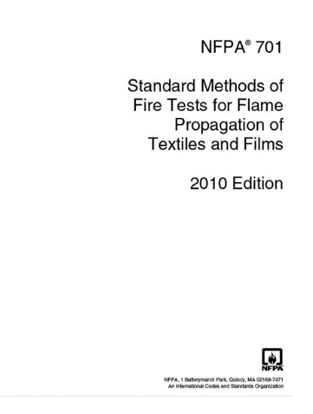
And one that is NOT APPLICABLE in Ontario, but from 1997 to 2007 was referenced in the code as the “Match Flame Test” NFPA 701, should have said NFPA 705.
NFPA 701 “Standard Methods of Fire Tests for Flame Propagation of Textiles and Films”
      Test Method #1
        10 samples, 15 by 40 cm taken lengthwise only
  Measures flash, after flame, flaming drips, char length, percent mass loss due to burning
        45 seconds flame exposure
      Test Method #2:
        10 samples, 12.5 by 120 cm- 10 samples, 4 samples of folded
        120 seconds of flame exposure
Notes:
Common misconception. Manufacturers provide 701 code as proof of flame retardant treatments, not Can/Ulc s109. Fact is, this standard is not the Canadian standard, so a certificate indicating NFPA 701 does not help to meet the requirements of the Fire Code. Confusion lies in 1997-2007 Fire Code references “Field Flame Test” NFPA 701, should have read 705

Slide 11
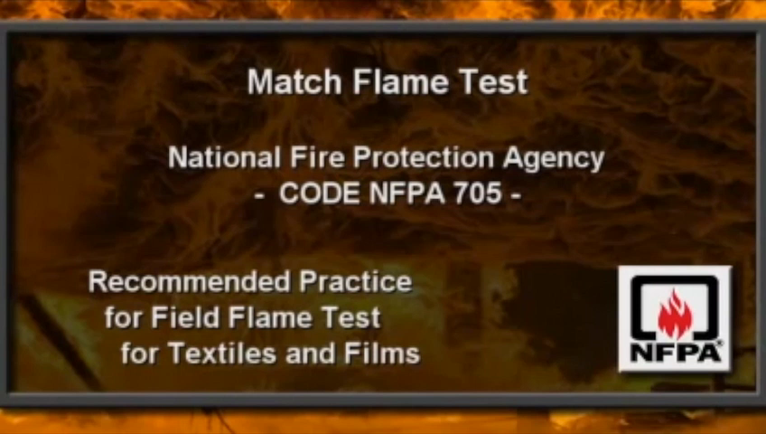

Slide 12
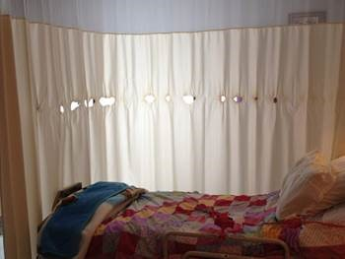
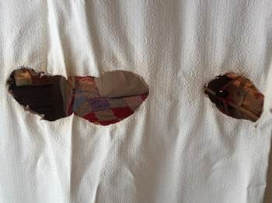
WHERE? ASSESSMENT OF RISK
Care, Treatment or Detention Occupancy:
  Where: Hospitals:
    Low risk, typically IFR fabrics throughout hospital.
    Window drapes largely replaced with blinds.
    Sprinklers Throughout
  Where: Nursing/Long Term Care
    Older Long Term Care facilities may have window and bedside drapery at risk. Also, home-made drapery common.
    Some do not yet have Sprinklers
    Recent Fires in Quebec and Whitby have highlighted sector for enforcement.
Notes:
Lots of other items in each of these categories, but when it comes to drapes, here is our field experience.

Slide 13
WHERE? ASSESSMENT OF RISK
2) Lobby or Exit of Any Public Building
  Where: Hotels, Retirement Homes, Stores, Condominiums, Businesses, Government Buildings, Community Centres
    -Decorative elements in public buildings
    -Risk that materials used are not IFR.
    -Even IFR drapes will fail if dirty .
    -Some installations have large windows with large amounts of textiles.
    -Risk that materials used were made using residential grade fabrics, not IFR

Slide 14
WHERE? ASSESSMENT OF RISK
3) Assembly Occupancies- More than 100 person load
  Where: Theatres, School Stages, Funeral Homes, Banquet Halls, Churches, Private Clubs, Golf Clubs, Restaurants/Nightclubs, Convention/Event Spaces
  - Elevated Risk due to large numbers of people assembled at once.
  - Hot Lights and Electrical Sparks increase risk on stages
  - Professional Theatres Typically are aware of Fire Code Certification for Drapery, Theatres however do not typically know that the flame retardant properties will wear off with the accumulation of dust and must be renewed every 3-5 years.
  - School Boards: Elevated risk draperies often in contact with hot lighting.
  Most school boards do not have a comprehensive program of testing and re- certification. Even failed results are ignored by schools as the board has not provided funding to re-certify the drapery to the schools. Boards specifying IFR draperies which are failing NFPA 705 testing after less than 1 year and are highly combustible
  - In Banquet and Restaurants the presence of open flame increases risk.
  - Churches, Private Clubs, Golf Clubs , Restaurants and Nightclubs often use non-IFR materials when creating decorative elements. Many items imported from the US, contain US certifications only.
  - No regime of testing & re-certification in place- Reactive only.

Slide 15
WHERE? ASSESSMENT OF RISK
4) Any building with open floor area greater than 1500 square metres
  Where: Shopping Malls, Public Buildings, Museums, Arenas, Universities, Indoor Sports Facilities, Community Centres
  -Typically few fabrics used in these areas, however, decorative elements, fake plants, netting and seasonal displays can present issues.
  - Museum art, quilts, decorative elements can be difficult to treat without affecting look and feel of fabrics, but most can be successfully treated.

Slide 16
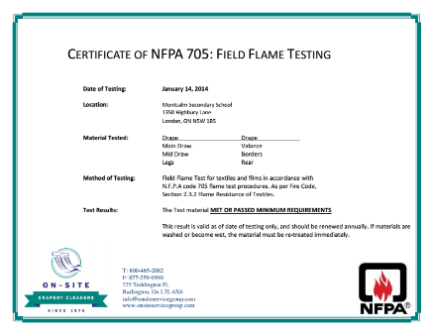
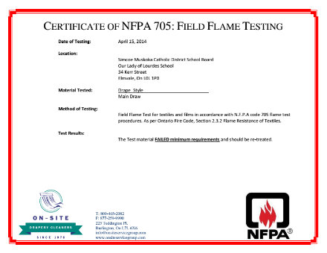
  The Solution: Part 1: NFPA 705 Testing
    Determine Actual Flammability Today: PASS or FAIL
2) For those which FAILED, evaluate two options to compliance:
      Replace All Draperies with new ones
      or Clean & Re-New Flame Retardant Treatments on Draperies
Notes:
Replace – Guess you could do that, but, 5 times cheaper to restore than replace and it is wastefull to throw out perfectly good drapes after 5 years which should last 20 years.

Slide 17
  The Solution: Part 2: Keep Track of Future Renewal Date
    Once we have completed re-treatment, we put a sticker on the drape and enter customer into our system and remind them when there drapes are due for re-treatments
How Often Should Flame Retardant Treatments be Renewed?
For Draperies in Public Buildings, Lobbies, Restaurants, Nursing, Retirement, which are exposed to light, food, liquids and high touch surfaces, we recommend annual re-testing and re-treatment every 3 years.
Draperies in Theatre Stages such as Theatres and School Gyms, typically treatments will last 5 years as they are not exposed to light and are heavier fabrics.
Notes:
Does depend on the environment. In New York and California, they need to be tested annually. In our experience, 3-5 years. Does depend on the fabrics themselves and the environment they are in.

Slide 18
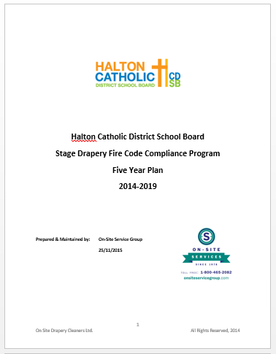
  The Solution: Part 3: School Boards with many sites
    School boards are high risk, draperies regularly come in contact with hot stage lights, electrical sparks and careless students.
    School Boards have literally hundreds of stages. Typically, certificates are lost in the bureaucracy of the school board. Most sites are well over 5 years old and Stage Drapery fire code compliance is often ignored until they are prompted.
    The solution is to have a 5 Year Plan implemented. We test all their sites, then we develop an ongoing plan to keep track of flame retardant treatments and re-testing schedule. Those which Fail are re-treated immediately, then scheduled for re-testing in 3-5 years. Those which Pass are re-tested sooner.
    Helps them to keep track and ensure all draperies have current flame retardant applied.
Notes:
We have seen many examples of fires on stages in school boards. Most commonly., someone moves a stage light such that it now comes in contact with the drapery. Or, careless students, remember these are the same kids who light the hand sanitizer on fire for fun!
If flame retardant is current, simply burns a hole in the drape. If not, could be catastrophic fire as drapes represent a large quantity of combustible materials.

Slide 19
  Fabric Types & Flammability Treatments:
    Drapery Flame Retardants are either Treated or Woven (Inherently Flame Retardant)
    Typically Drapery is Treated as Woven IRF drapes cost 50% more and have limited choice of fabric and colour types thus are less common
    All types require cleaning every 5 years. Both types of drapes require cleaning and/or retreatment as even IFR drapes will Fail the flame test as dust is highly flammable and acts as an accelerant
    Loose threads burn easily thus drapes with rips or unfinished edges will also Fail
    The fabric weight and weave will affect flammability of fabrics. Fabrics with a tight weave are less likely to ignite than the same fabric in a looser weave.
    Surface texture also will affect flammability. Long, fluffy pile materials such as nap on a velour drapes are more likely to ignite that a hard tight surface.
    If certificate is more than 5 years old, the drapes should be re-tested.
Notes:
Describe difference between FR’s
So, how often is as often as required? Good question. Answer is, it depends.
Overall, typically all drapes require cleaning and re-treatment every 5 years.
Different fabrics have different life spans- typically MD longer lasting than commandos.

Slide 20
Flame Retardant Treatments
How it Works
How is it applied
Why is wears off
What happens when wet?
Chemical Composition
Environmental & Toxicity Information
Notes:
How it works- Wraps fibres in mineral coating which disrupts the burning cycle by preventing fire from access combustible materials.
How is it applied_ Important to coat fabric with even layer of FR, too much, will leave salt like blotches on drapes, too little, will not be effective.
Why it wears off: Describe it being moved, falling off and collecting dust.
Show SAMPLE MTCC
Chemical Composition: Similar to salt, Bromine solution- PASS IT AROUND
Environmental- Not the ones used in furniture linked to cancer. Those are: polybrominated diphenyl ethers, or PBDEs act like PCB’s in environment. Ours is not hazardous.

Slide 21
Flame Retardant Treatments
Wide Variety of Chemicals Used to inhibit, suppress or delay combustion of materials. Two primary types:
  Halogenated - Chemically Alter under combustion
    Includes - Brominate, Chlorine and Nitrogen.
  Thermal Shielding - Non-combustive barrier between the flame and combustible materials.
    Includes – Phosphorous – most commonly used in textiles, furniture, plastics, electronics and foam.
Notes:
How it works- Wraps fibres in mineral coating which disrupts the burning cycle by preventing fire from access combustible materials.
How is it applied_ Important to coat fabric with even layer of FR, too much, will leave salt like blotches on drapes, too little, will not be effective.
Why it wears off: Describe it being moved, falling off and collecting dust.
Show SAMPLE MTCC
Chemical Composition: Similar to salt, Bromine solution- PASS IT AROUND
Environmental- Not the ones used in furniture linked to cancer. Those are: polybrominated diphenyl ethers, or PBDEs act like PCB’s in environment. Ours is not hazardous.

Slide 22
HISTORY OF Flame Retardants
The use of flame retardants plays an important role in fire safety.
  Many household goods are made from natural or petrochemical flammable
  California Technical Bulletin TB-117 – 1975 – Defacto National Standard of flame retardants in furniture.
  Retardants were added to a wide variety of consumer goods
    furniture, plastics, nylons, electronics, appliances, toys and even kids pyjamas.
  One family of these chemicals, the halogenated polymeric brominated compounds (BFRs) have been linked to cancer, can be a neurotoxin and cause thyroid problems.
Notes:
How it works- Wraps fibres in mineral coating which disrupts the burning cycle by preventing fire from access combustible materials.
How is it applied_ Important to coat fabric with even layer of FR, too much, will leave salt like blotches on drapes, too little, will not be effective.
Why it wears off: Describe it being moved, falling off and collecting dust.
Show SAMPLE MTCC
Chemical Composition: Similar to salt, Bromine solution- PASS IT AROUND
Environmental- Not the ones used in furniture linked to cancer. Those are: polybrominated diphenyl ethers, or PBDEs act like PCB’s in environment. Ours is not hazardous.

Slide 23
Flame Retardant Treatments
In January 2015, TB-117-2013 came into effect.
Revision
  lowered the flame testing standard on individual components and
  Focused on the flammability of final assembled item.
Products manufactured after January 1, 2015 require a label disclosing flame retardants used, if any.
IMPORTANT - TB-117-2013 does not prevent manufacturers from using flame retardants BUT makes it possible to manufacture without flame retardant chemicals.
Notes:
How it works- Wraps fibres in mineral coating which disrupts the burning cycle by preventing fire from access combustible materials.
How is it applied_ Important to coat fabric with even layer of FR, too much, will leave salt like blotches on drapes, too little, will not be effective.
Why it wears off: Describe it being moved, falling off and collecting dust.
Show SAMPLE MTCC
Chemical Composition: Similar to salt, Bromine solution- PASS IT AROUND
Environmental- Not the ones used in furniture linked to cancer. Those are: polybrominated diphenyl ethers, or PBDEs act like PCB’s in environment. Ours is not hazardous.

Slide 24
ENVIRONMENTAL AND TOXICITY
Mineral Based
  includes salts, phosphors, sulfurs and other mineral based coatings.
Contain NO Volatile Organic Compounds (VOC’s), PCB’s or PSDE’s therefore non-hazardous.
The Health, Flammability, Reactivity ratings are all 0
  Slight hazards listed are related to prolonged skin exposure or eye contact – irritations
  Ingestion of large quantities may, however, cause gastrointestinal discomfort, so don’t drink it.
Notes:
How it works- Wraps fibres in mineral coating which disrupts the burning cycle by preventing fire from access combustible materials.
How is it applied_ Important to coat fabric with even layer of FR, too much, will leave salt like blotches on drapes, too little, will not be effective.
Why it wears off: Describe it being moved, falling off and collecting dust.
Show SAMPLE MTCC
Chemical Composition: Similar to salt, Bromine solution- PASS IT AROUND
Environmental- Not the ones used in furniture linked to cancer. Those are: polybrominated diphenyl ethers, or PBDEs act like PCB’s in environment. Ours is not hazardous.

Slide 25
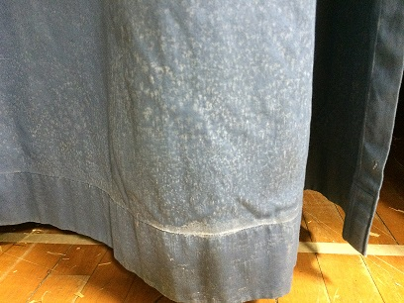
  Drapes must be cleaned prior to re-treatment with flame retardant.
    Why?
      Flame Retardant will adhere to dust and fall off rapidly.
      Manufacturers Specification: Warrantee is void if applied incorrectly.
      Stains the drapes, sometimes permanently.
Notes:
First, why do we need to clean the fabrics before applying flame retardant. Trust me, you do.

Slide 26
How do you Clean Draperies?
Wash Them ?
Have them Dry Cleaned ?
Steam Clean Them?
Vacuum Them ?
Non-Immersion Cleaning ?
Notes:
Going to review each method of cleaning drapes.

Slide 27
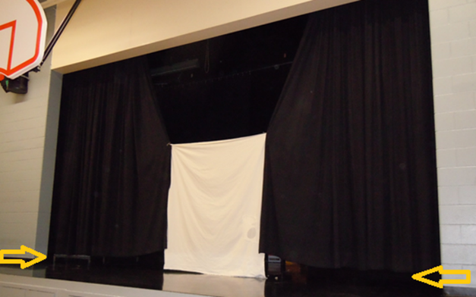
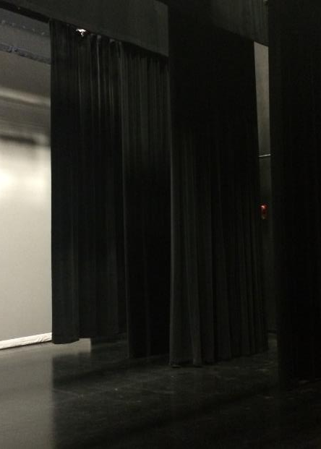
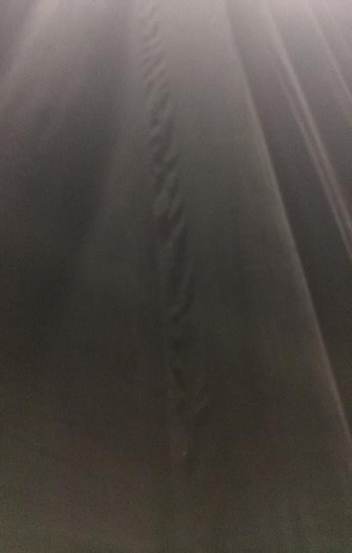
Results of Washing: Notice Shrinkage & Pulled Seams
Notes:
Most drapery has never been immersed in liquids, when it is, it shrinks.
If not IFR fabrics, all flame retardant treatments are soluble in liquids will wash out if they become wet with water of dry cleaning fluid.

Slide 28
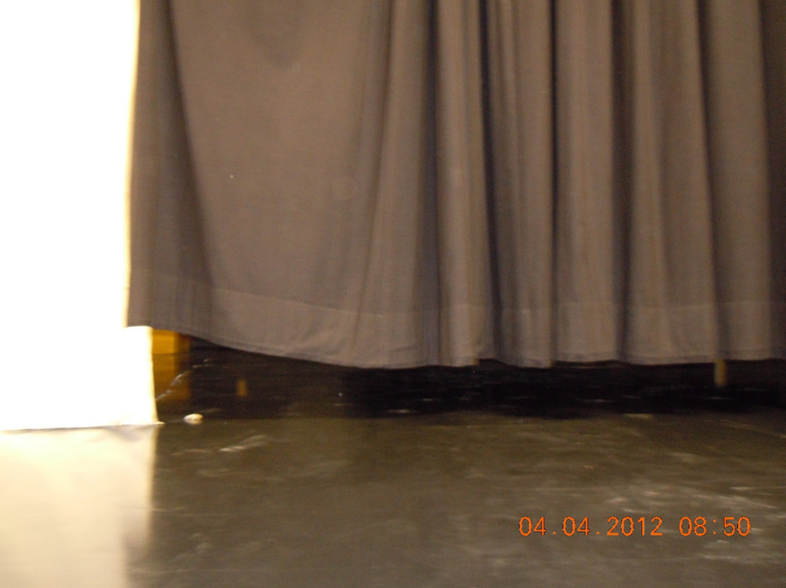
  Results of Washing Drapes:

Slide 29
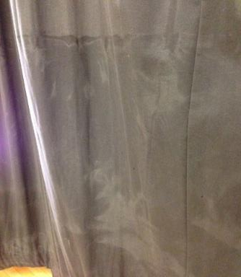
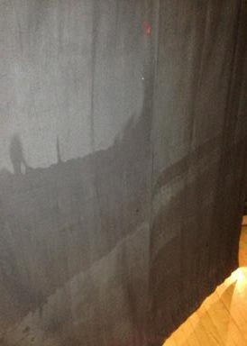
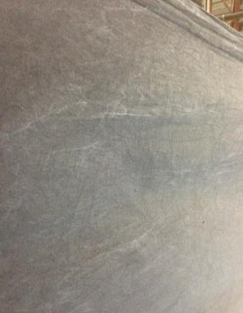
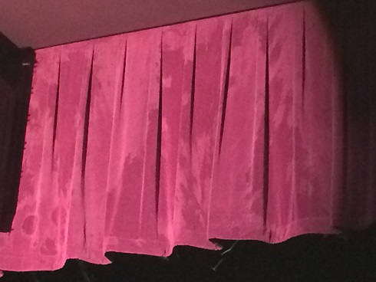
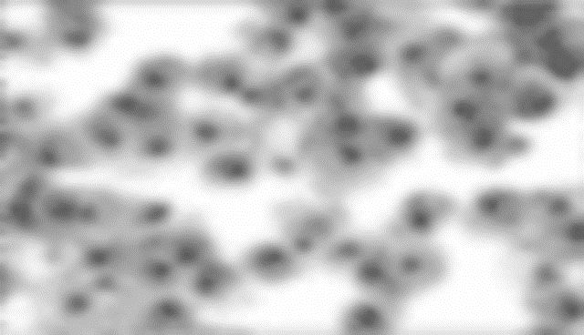
Results of Dry Cleaning Draperies
Dry Cleaning Results:
In lab tests, under a microscope, fibres in the traditional dry cleaning method sample appeared degenerated, lacked colour, and were matted with grape like clusters of dirt (re-deposition of dirt) throughout.
Notes:
Dry cleaning fluid is also a liquid, has similar results as water. Also can burn in existing flame retardants causing permanent staining.

Slide 30
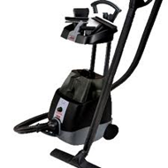
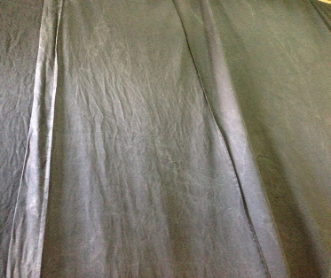
Results of Steam Cleaning
    Using hand held attachments connected to carpet cleaning machines. With minimal suction without a solid surface backing, most of the dirty water is injected deeper into the drape producing mould and mildew as they dry. Drapes are left with limp and wrinkled look .
    Drapes absorb so much water, they can pull tracks right out of the ceiling.
    Use of liquid injection causes flame retardants to be removed.
Drapes which have been steam cleaned- limped look, patchy flame retardant

Slide 31
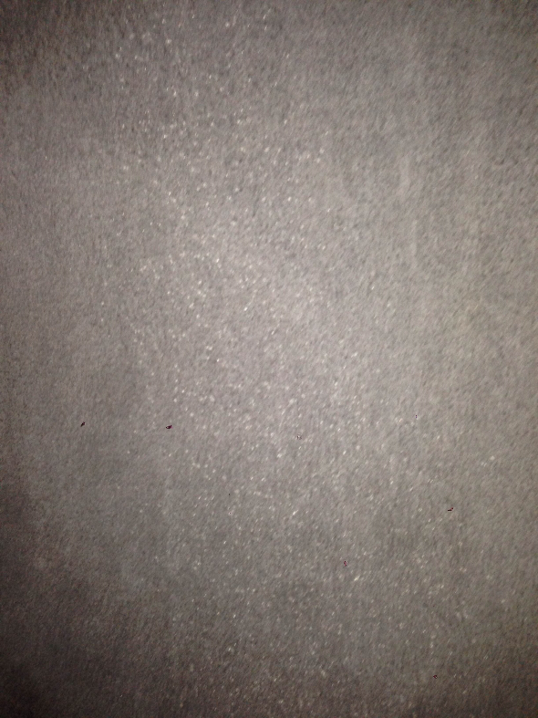

Drapes Cleaned by vacuum only prior to flame retardant application
Vacuuming between deep cleaning cycles will remove surface dust. However, due to be absence of a solid backing, vacuums have difficult generating sufficient suction to remove embedded dirt.
If dirt is not sufficiently removed, once flame retardants are re-applied will cause staining as dirt congeals with liquid flame retardant.
Note heavy spotting
Notes:
Vacuuming: Vacuuming is not an effective method of cleaning draperies and is not recommended. Vacuuming drapes is not the same as vacuuming carpets, with carpets, there is a solid backing to create suction. With drapes, none. It is very time consuming and even with great care, vacuuming drapes will not remove the dust and soil embedded in fabric fibres, in particular up in the pleats and embedded in heavy stage drapery fabrics.
When flame retardant is applied to drapes which have not been cleaned thoroughly, it results in spotting and uneven application. Below is a photo of a drape which was cleaned by vacuum only prior to application of flame retardant.
Also, vacuuming will stir up considerable dust into the air, negatively affecting air quality and it then this dust settles throughout the stage and gym.
Not Safe to access
Up high in pleates
Dark
If Miss a spot, then not flame retardant.

Slide 32
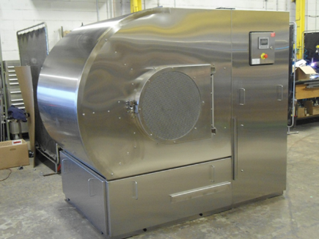
Non-Immersion Cleaning
Non-Immersion Cleaning: Preferably, draperies should be cleaned using non-immersion cleaning technology, which does not expose draperies to liquids of any kind.
Drapes are cleaned using powder, which combined with action of the drum, a powerful forced air extraction process and series of filters effectively removes dirt, odour and soil from drapes.
Our motor creates 3,000 cubic feet per minute of suction, 30 times that of a vacuum.
Notes:
SHOW SAMPLES
Questions on cleaning process? Almost done, talk a bit about a typical project. Clean & FR

Slide 33
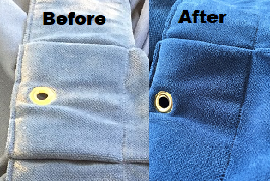
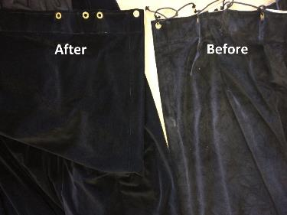
The Non-Immersion Advantage
No Shrinkage: Unlike clothing, drapery fabrics are not pre-washed. When fabric fibres are exposed to liquids of any kind- either water or dry cleaning fluid, they will shrink considerably.
No Colour Fade or Bleed: The colours of your drapery are critical. Why fade them away? Be wary of bleeding of colours, if immersed, dyes will run.
No Fabric Damage: On-Site’s non-immersion cleaning method is the gentlest way to clean your drapery. Traditional cleaning methods will lead to damage and distortion of fabric fibres.
No Distortion of Pleats and Seams: Fabrics immersed in liquids will lose their shape resulting in lost pleats and limp looking. To address this, traditional dry cleaners will then use steaming, pressing and re-pleating machines. Heat and pressure degrade your fabric fibres.
Gentlest Method. Period. There is no better method of cleaning drapery. Our proprietary system is so gentle we can even clean delicates, blackout-lined drapes, silks, & embroidered decorative draperies.
Won’t Remove Flame Retardant: Since we don’t use liquids, we don’t affect the flame retardant.

Slide 34


ENVIRONMENTALY FRIENDLY
  The Greenest- Especially since our competitors are still using perchloroethylene- a know carcinogen
  Non-immersion process means no toxic Dry- Cleaning Fluids to be disposed of and no waste water
  No Energy wasted making hot water
  On-site’s waste is completely non-toxic
  No trace of residual toxins on your drapes
  TOTAL SAVINGS LAST YEAR ALONE:
  120,000 Gallons of hot water saved or
  40,000 fewer Gallons of perchloroethylene Toxic Dry Cleaning Fluid to be disposed of
Notes:
When we present our proposal to you we will calculate exactly how much hot water and dry cleaning fluid you are saving by choosing On-Site.
In fact, we calculate that by cleaning an average stage using our process saves over 80 gallons of dry cleaning fluid or 240 gallons of hot water.

Slide 35
Summary
1) Drapes are naturally highly flammable unless treated with flame retardant. Flame Retardant needs to be renewed.
HOW OFTEN: Flame Retardant wears off within 3-5 years or if fabric gets wet or is immersed in liquids.
2) Fire Code Requirements: WHAT, WHICH TEST, WHERE
WHAT: Drapes, Curtains, Textiles, Banners, Flags and Wall Coverings
WHICH TEST:
        New Drapes: CAN/ULC S-109 Certification Required
        Existing Drapes: Fire Code requires flame proofing treatments shall be renewed as often as required to pass NFPA 705
    WHERE: Healthcare Facilities, Lobbies & Exits, Assembled Occupancies
    WHEN: Fire Code says “as often as required”
3) The Solution: REGULAR TESTING
PART 1: Establish current flammability
PART 2: Track Re-Testing and Re-Treatment Dates
PART 3: For Multi-Site Clients Such as School Boards- Establish 5 Year Plan

Slide 36
Summary
4) Fabric Types & Flammability Treatments:
Dipped or Woven (IFR)
All fabrics must be cleaned prior to re-application of flame retardant
Typically Flame Retardant Needs to be re-applied ever 3-5 years
5) Drapery Cannot be Safely Washed or Dry Cleaned without removing flame retardant
Non-Immersion Cleaning is best
6) Drapery can be Cleaned and Re-Treated for a Fraction of the Cost of Replacement
7) On-Site Service Group is a specialist in this field offers the following services:
    Testing & Re-Certification
    Cleaning
    Flame Retardant Re-Application
    Tracking of Re-Testing & Re-Application dates
    Implementation of 5 Year plans for multi-site clients such as school boards
If you are in doubt of the compliance of any facility, simply have them contact us.

