Slide 1
Diversity 101
Presented by
Shannon Yates BA, MA

Slide 2
Land Acknowledgement
-it is vital for truth and reconciliation that we acknowledge the Original People of this land
-National Indigenous History Month

Slide 3
Agenda
Introduction
Preparing our minds
The Past
Law
Diverse groups
Practice and Perspective
Conclusion
Notes:
How presentation will benefit audience: Adult learners are more interested in a subject if they know how or why it is important to them.
Presenter’s level of expertise in the subject: Briefly state your credentials in this area, or explain why participants should listen to you.

Slide 4
Introduction
My name is Shannon Yates, and currently I am the Public Safety Fundamentals Program Coordinator at Fanshawe College. I also am full-time faculty in the School of Public Safety. I teach sociology courses such as Diversity
I possess a Master of Arts in Religion and Culture, a Bachelor of Arts in Human Rights and Human Diversity, as well as a Police Foundations Diploma and a Law and Security Administration Diploma. 12 year career in various security roles at Woodstock Slots (Casino)
Notes:
Lesson descriptions should be brief.

Slide 5
Preparing our minds
Before we can learn we must prepare our minds
Prepare ourselves to receive and be open
Establish a foundation
Create a safe space
Check in with ourselves

Slide 6
Preparing our minds
What is diversity?
Notes:
Example objectives
At the end of this lesson, you will be able to:
Save files to the team Web server.
Move files to different locations on the team Web server.
Share files on the team Web server.

Slide 7
Preparing our minds
How would you describe/define diversity?
“the condition of having or being composed of differing elements : VARIETY; especially the inclusion of people of different races, cultures, etc. in a group or organization” (Merriam-Webster.com Dictionary, 2022, n.p.).
“is about the individual. It is about the variety of unique dimensions, qualities and characteristics we all possess” (Canadian Centre for Diversity and Inclusion, 2022, n.p.).

Slide 8
Preparing our minds
“the variety of human qualities among different people and groups” (Boyington, 2020, p. 4).
Establishing a definition of diversity is important in its application.

Slide 9
Preparing our minds
Prejudice …
“an adverse judgment or opinion formed with little or no knowledge or experience or examination of the facts … “ (Boyington, 2020, p. 88).
Most individuals when polled do not believe they hold any prejudice, but rather, hold an open mind toward various groups and people.

Slide 10
Preparing our minds
In 2011 National Household Survey, 9,000 Canadians self-identified their religion as jedi (knight) (Boyington, 2020).
What vision do you have?
What do you think of?

Slide 11
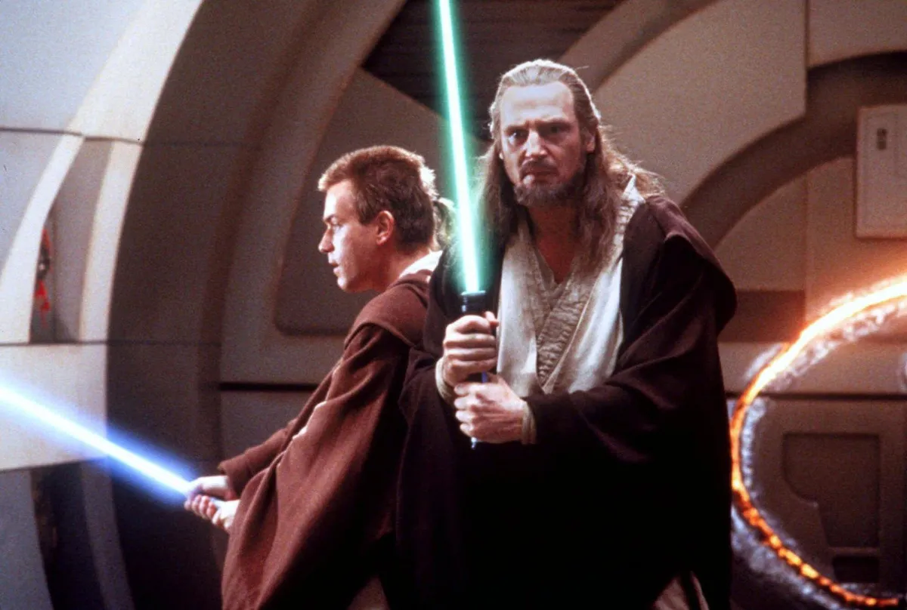
Preparing our minds

Slide 12
Preparing our minds
Based on philosophies in Buddhism and Daoism – can be seen in the Star War movies
It is not role play or people having light sabre fights
It is about self-mastery
Many people when they first hear this statistic automatically think of role play.
Reflect on our definition of prejudice – application to this example
Dangers of prejudice - Islamophobia

Slide 13
Preparing our minds
What are fire services saying?
“Diversity is not a problem to be managed, it is value added to your service” (Chief Jonna Olsson, n.d., n.p.).
“Our vision is for gender equity to be the norm – not the exception” (FSWO, n.d., n.p.).
“The CAFC recognizes that diversity, inclusion, racial and gender equity issues are being raised within fire services and about fire services across the country. It is our goal to have the fire service mirror the diversity we see in all people of our country” (CAFC, n.d., n.p.).

Slide 14
Preparing our minds
I want you to keep the previous slides in mind – reflect on them frequently as we further learn about diversity

Slide 15
The Past
Many Canadians are not aware of Canada’s past. In order to move forward we must acknowledge the past. The past still impacts the present.

Slide 16
The Past
Komagata Maru - May 23, 1914
Japanese steam ship enroute from Hong Kong to Vancouver
376 passengers only 20 allowed to disembark
1908 Continuous Passage Act
July 23, 1914 escorted out of the harbour
Arrival in India 19 were killed clash with British soldiers

Slide 17
The Past
Chinese Head Tax
1885 Act to Restrict and Regulate Chinese Immigration
  Chinese Head Tax - $50 later increased to $500
The Chinese Immigration Act 1923
Many Chinese Immigrants were brought in as manual labourers building the CPR (1881-1885)

Slide 18
The Past
Viola Desmond
Champion of Black Peoples rights – fought segregation
November 1946 – New Glasgow Nova Scotia
Segregation at the theatre
She refused to sit in the balcony section
Arrested, charged and convicted for tax evasion – 1 cent
Inspired Canada’s civil rights movement

Slide 19
The Past
1850 The Separate Schools Act – enabled white people to relegate Black People to all Black schools with exclusively Black Teachers. The practice continued until the 1960s
1920s the KKK grew to the point of having 119 chapters throughout Canada
1924 the city commission of Edmonton banned all Black People from public parks and swimming pools
Indigenous People could not vote until the 1960s

Slide 20
Law
Very important to understand and visit legislation both provincially and nationally, that supports diversity, equity and inclusion
Multiculturalism
Multiculturalism Policy 1971 and then Multicultural Act 1988
Informal multiculturalism
Canada is described as a mosiac

Slide 21
Law
Multiculturalism Act 1988
“AND WHEREAS the Government of Canada recognizes the diversity of Canadians as regards race, national or ethnic origin, colour and religion as a fundamental characteristic of Canadian society and is committed to a policy of multiculturalism designed to preserve and enhance the multicultural heritage of Canadians while working to achieve the equality of all Canadians in the economic, social, cultural and political life of Canada …” (Government of Canada, 1988, n.p.)

Slide 22
Law
Multiculturalism Act 1988 cont’d
3 (1)(a) “recognize and promote the understanding that multiculturalism reflects the cultural and racial diversity of Canadian society and acknowledges the freedom of all members of Canadian society to preserve, enhance and share their cultural heritage” (Government of Canada, 1988, n.p.)

Slide 23
Law
Ontario Human Rights Code
Proclaimed 1962
Today there are 17 protected grounds: citizenship, race, place of origin, ethnic origin, colour, ancestry, disability, age, creed, sex/pregnancy, family status, marital status, sexual orientation, gender identity, gender expression, receipt of public assistance (in housing) and record of offences (in employment).
5 protected social areas: employment, housing, services, unions and vocational associations and contracts.

Slide 24
Law
Ontario Human Rights Code cont’d
“The Code’s goal is to prevent discrimination and harassment because of race, sex, disability and age, to name a few of the 17 grounds. All other Ontario laws must agree with the Code” (Ontario Human Rights Commission, n.d., n.p.).

Slide 25
Law
The Charter of Rights and Freedoms (1982)
Fundamental freedoms
2 Everyone has the following fundamental freedoms:
(a) freedom of conscience and religion;
(b) freedom of thought, belief, opinion and expression, including freedom of the press and other media of communication;
(c) freedom of peaceful assembly; and
(d) freedom of association.

Slide 26
Law
The Charter of Rights and Freedoms cont’d
Equality Rights (1985)
Equality before and under law and equal protection and benefit of law
15 (1) Every individual is equal before and under the law and has the right to the equal protection and equal benefit of the law without discrimination and, in particular, without discrimination based on race, national or ethnic origin, colour, religion, sex, age or mental or physical disability.

Slide 27
Law
Why is reviewing the law important?
Promotes diversity
Protects diversity
Applies to all
Holds every citizen accountable
Rights and responsibilities

Slide 28
Diverse Groups
According to the 2016 Census, more than 250 different ethnic groups in Canada
19% of Canadian population is of visible minority
More than one-quarter of Ontario’s population belongs to visible minority groups
Ontarians comprise more than half of the total visible minority population in Canada
3 largest visible minority groups are: South Asian People 25%, East Asian People 21%, and Black People 15%
(Boyington, 2020)

Slide 29
Diverse groups
Canada has a long history of immigration – Indigenous People are the Original People of this land
Canada continues to assist and welcome both immigrants and refugees
Refugees are a human rights crisis
November 4, 2015 to August 1, 2016, 29,713 Syrian refugees were resettled (Boyington, 2020).

Slide 30
Diverse Groups
Religions in Canada
67.3% of Canadians self-identified as Christian
3.2% of Canadians self-identified as Muslim
1.5% of Canadians self-identified as Hindu
1.4% of Canadians self-identified as Sikh
1.1% of Canadians self-identified as Buddhist
1% of Canadians self-identified as Jewish

Slide 31
Diverse Groups
Hate Crimes
47% increase police reported hate crimes 2017
43% perpetuated because of race and ethnicity – Black People are the highest targeted
40% perpetuated because of religion – Jewish (antisemitism) highest targeted
10% perpetuated because of sexual orientation – most violent of all hate crimes

Slide 32
Diverse Groups
The horrific murders of the Azfaal family beckon us to promote acceptance and tolerance of all people as well as the rights of all
I have had a number of students in my teaching career who have shared their horrific experiences with racism and discrimination
Students have shared that their parents instructed them not to tell anyone that they are Jewish, or Muslim or a member of the LGBTQ2+ community
My own experiences in a male dominated field

Slide 33
Practice and Perspective
Diversity, equity and inclusion are a vital component for our communities
We have defined diversity -the variety of human qualities among different people and groups. Equity and Inclusion are an act. Equity goes beyond equality because it provides specific supports for individual needs. It seeks to remove barriers for individuals. Inclusion I am sure we all understand and agree it is being inclusive

Slide 34
Practice and Perspective
How do we promote diversity, equity and inclusion for all?
We reviewed various aspects of diversity – take that understanding and knowledge and apply it to your own personal lives (inclusive of work)
Engage and act for equity and inclusion
Share what you have learned – be an agent for change
Offer kindness, dignity, and respect to all people
Volunteer or attend various events – support the diverse members of your community (great learning opportunity)
Uphold your responsibilities as a human rights bearer

Slide 35
Conclusion
It really is up to each of us to uphold not only laws, but even more importantly each other. After all, our diverse nation is what makes it as beautiful as it is. Be kind, and thank you!
Thank you for inviting me here today to share with you about diversity. Thank you to Julianne and Frank for giving me this opportunity.

