Slide 1
Inspection Orders and Fire Marshal Reviews
Tawnya Roberts and Sunaina Menezes
Office of the Fire Marshal

Slide 2
Overview
An overview of key aspects of Inspection Orders issued under the Fire Protection and Prevention Act, 1997 and the administrative process of conducting Fire Marshal Reviews.
FPPA – relevant sections
OFM IO Templates
FM Review administrative process
Inspection Orders – key elements
IO Common Themes/Concerns/Asks
Case Studies

Slide 3
FPPA – Section 21(1), Inspection Orders
An inspector who has carried out an inspection of land or premises under section 19 or 20 may order the owner or occupant of the land or premises to take any measure necessary to ensure fire safety on the land and premises and may for that purpose order the owner or occupant,
(a) to remove buildings or structures from the land or premises;
(b) to make structural and other repairs or alterations, including material alterations, to the buildings or structures;
(c) To remove combustible or explosive material or any thing that may constitute a fire hazard;
(d) to install and use specified equipment or devices as may be necessary to contain hazardous material on the land or premises and, in the event of a fire, to remove or transport the material;
(e) to discontinue the manufacturing, production or fabrication of any material, device or other thing that creates or poses an undue risk of fire or explosion;
(f) to do anything respecting fire safety including anything relating to the containment of a possible fire, means of egress, fire alarms and detection, fire suppression and the preparation of a fire safety plan;
(g) to remedy any contravention of the fire code.

Slide 4
FPPA – Section 23, Contents of Order
An order made under subsection 21 (1) or (2) shall set out,
(a) the reasons for the order;
(b) an explanation of the action required by the order;
(c) the time within which the owner or occupant must comply with the order; and
(d) the right to request a review of the order by the Fire Marshal under section 25 or, in the case of an order made by the Fire Marshal, the right of appeal to the Fire Safety Commission under section 26.

Slide 5
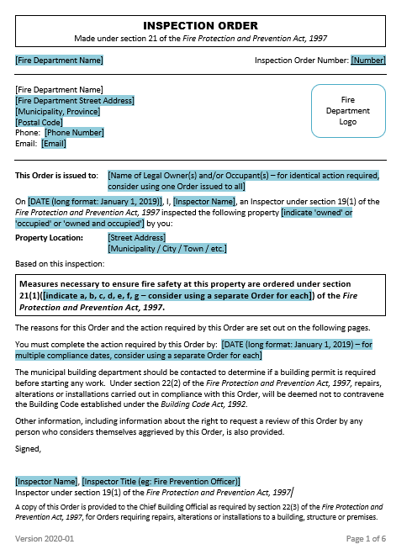
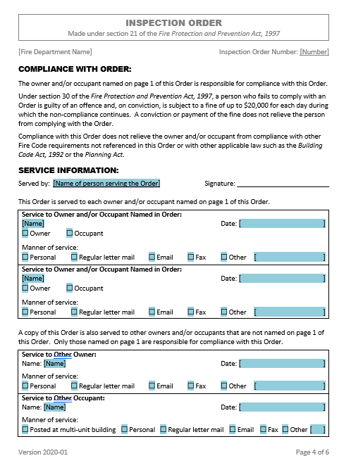
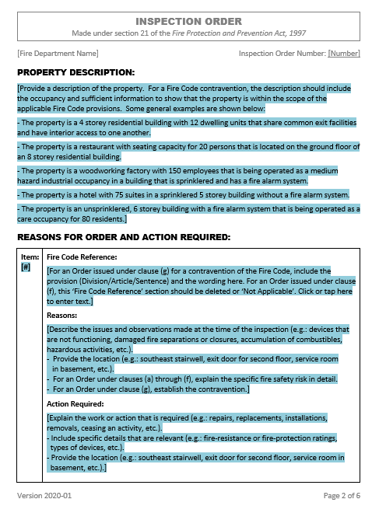
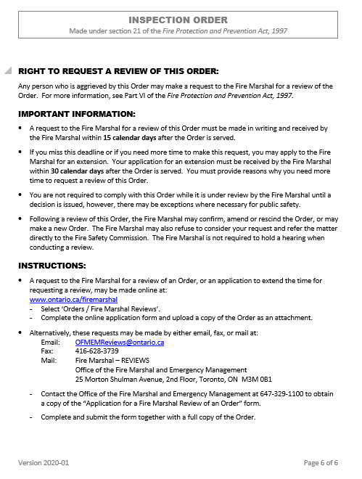
OFM Inspection Order Template

Slide 6
Right to Request a Fire Marshal Review
The actions in an Order must be carried out by the owner/occupant that the Order has been issued to.
FPPA Section 25
Any person that is aggrieved by an Order may request a Fire Marshal Review of the Order. The decision from the Fire Marshal Review will confirm, amend, or rescind the Order.
FPPA Section 26
Any person that is aggrieved by a decision from the Fire Marshal Review may appeal to the Fire Safety Commission.

Slide 7
Fire Marshal Review Process
The Fire Protection Engineers in Technical Services Section have received delegated authority from the Fire Marshal to carry out all Fire Marshal Reviews.
Initiating a Fire Marshal Review
Screening
Acknowledgement and Supporting Information
Technical Review
Decision
Appeal to the Fire Safety Commission

Slide 8
Initiating a Fire Marshal Review
A request to the Fire Marshal for a review of an Order must be within 15 calendar days after the Order is served.
If additional time is needed to make a request, the Fire Marshal may grant an extension. The request for an extension must be received by the Fire Marshal within 30 calendar days after the Order is served. Reasons for the extension must be provided.
The Order is stayed when a review is requested. However, the stay may be lifted upon request if necessary for public safety.
A request may be made online (preferred) or by email, mail, or fax.
Days are counted using the provisions/rules in the Legislation Act, 2006.

Slide 9
Initiating a Fire Marshal Review
A request for a Fire Marshal Review may be made if someone is:
Disputing the action required by the Order.
Asking for additional time to comply with the Order.
Aggrieved by the Order for any other reason.
An applicant (or their representative) must complete and submit an application form to request a Fire Marshal Review.
The application form collects initiation information about why they are aggrieved by the Order.
This information is shared with the fire department.
The scope of the Fire Marshal Review may be limited to the matters identified on the application from.

Slide 10
Screening
When an application for an FM Review is received, it is screened.
The screening stage checks that:
The request was received within the time provisions stated in the FPPA.
The Order includes the minimum information required by the FPPA.
There are no obvious and fatal flaws with the Order.
There is no known OFM involvement with the Order.
After the screening stage is completed, the request may be accepted, denied, invalid, or referred to the Fire Safety Commission.
If the Order is found to contain a ‘fatal flaw’ it may be rescinded at the screening stage.

Slide 11
Acknowledgment / Supporting Information
When an FM Review request has been accepted, an acknowledgement letter is sent to the applicant and the fire department.
The Order is stayed pending the outcome of the FM Review.
The acknowledgement letter includes information from the application form stating why the person is aggrieved by the Order.
The applicant and the fire department may provide supporting information for the FM Review.
A specific form is used to collect supporting information that is targeted to only the issues under review, as identified by the applicant.

Slide 12
Supporting Information Guidelines
Submissions should:
Be legible and limited to relevant matters under dispute as identified in the application form and acknowledgement letter.
Contain pertinent information that has been extracted, transcribed, and summarized from technical reports, inspection notes, or other documents.
Note: If submitting copies of inspection notes, copy ONLY those parts relevant to the matters in the IO and identify them accordingly.
Include brief description where providing photographs, diagrams, and floor plans.
Not include copies of personal identification (e.g.: driver’s licence, health card, etc.).
Not include copies of the Inspection Order, acknowledgement letter, or other correspondence received from OFM as these are already on file.

Slide 13
Supporting Information Form
Sections
Building Description
Occupancy Information
Inspection Order Items
Attachments

Slide 14
Technical Review / Decision / Appeal to FSC
A Fire Protection Engineer from Technical Services Section conducts the FM Review.
The Reviewer will evaluate the reasons and actions for the Order, and the supporting information provided by the applicant and the fire department.
The Reviewer will issue a Decision. The Decision may confirm, amend, or rescind the Order, in whole or in part.
A new compliance date for the Order is provided with the Decision.
The Decision will include the supporting information provided by the Applicant and the Fire Department.
Any aggrieved person may appeal the FM Review Decision to the Fire Safety Commission.

Slide 15
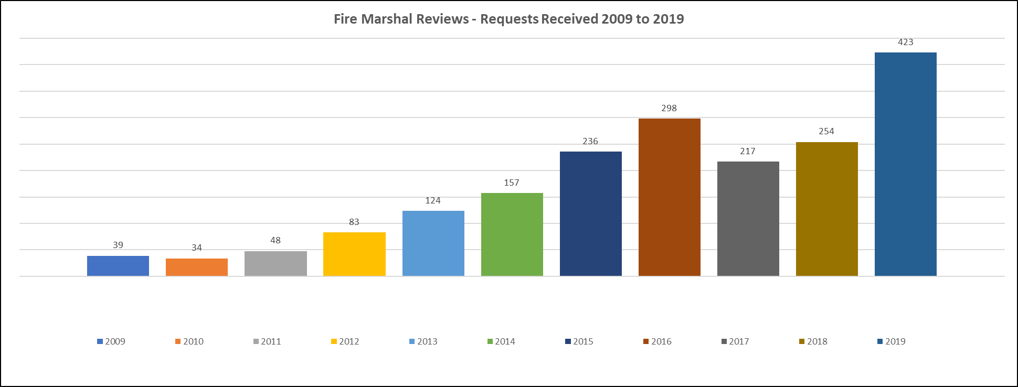
Numbers & Graphs – 10 Years of FM Reviews

Slide 16
Inspection Orders – Property Description
Highlights
Include a description of the building that “paints a picture” for all parties and is relevant to the IO.
How high, how big, how many units and how is it used? Factors that are linked to the requirements of the Fire Code.
Use terms from the Fire Code “building height, building area, # of dwelling units, residential suites, sleeping accommodations, occupant load, classifications and for Part 9 applications include application statements.

Slide 17
Inspection Orders – Property Description Example
#1 - The building is three storeys in building height, is 725 m² in building area and contains 20 residential dwelling units. The building meets the application statement of sentence 9.5.1.1.(1) where at least two dwelling units share common exit facilities and have interior access to one another.
#2 - The building is one storey in building height with a basement and was built in 1967 as a single residential dwelling unit. In 1975 the building underwent construction such that the building now contains two residential dwelling units with one on the first story and the second one in the basement floor area. The building meets the application statement of sentence 9.8.1.1.(1) where: (insert OFC ref)
#3 - The building is one storey in building height and contains a commercial manufacturing operation. The building is equipped with a fire suppression system and a fire alarm system.

Slide 18
Inspection Orders – Reasons
Using 21.(1)(g) “to remedy a contravention of the Fire Code”,
Must clearly establish what the contravention is, and where so it is actionable
Ensure the correct Code reference is used!
Using 21.(1)(f) to do anything respecting fire safety including anything relating to the containment of a possible fire, means of egress, fire alarms and detection, fire suppression and the preparation of a fire safety plan,
Generally used for an occupancy not addressed in Retrofit
Must clearly establish what the fire safety issue is, and why something that is currently unregulated is required
Tip: Use the Fire Code functional and objective statements to articulate the impact of why the work is necessary to address the fire safety issue

Slide 19
Reasons – Example
#1: (The property description clearly states the commercial building contains a fire alarm system and the Inspection Order has the correct OFC ref’s that deal with FAS testing and requirements for test records, Part 6 and 1.)
REASONS: During the inspection the annual fire alarm test record was not made available for review.
#2: (The property description clearly described the mixed classifications of the building as residential on floors 2-4 with Assembly on main floor, and the correct Fire Code ref for damaged fire separations between major occupancies and issues with cooking operations.)
REASONS: Breaches were observed in the following areas:
Ceiling/floor assembly between the first floor supply storage room and the residential unit on the 2nd storey
Wall between the first floor laundry room (used by the residential tenants) and the women’s washroom serving the restaurant (Class A assembly occupancy).

Slide 20
Inspection Orders – Action Required & Date
Action required (work ordered) should be:
Clearly stated, but not “how” the work is to be undertaken.
Ample wording that mirrors wording in the fire code:
repair breach of fire separation with similar materials to the existing construction vs.
fix the hole in the service room wall with 5/8 drywall installed by AJ builders
More than just referencing code requirement.
Within your authority to require******
Time to do work,
Should be reasonable for the work required to be done, especially if it includes construction – about 3 to 4 months is required!
Design, tendering, building permit, construction.
If Applicant is only asking for more time, this should be something that can be discussed at the local level.

Slide 21
Inspection Orders – Common Themes
Hoarding
Vulnerable Occupancies
Two Unit Residential Occupancies
Fire Safety Plans
Protection of commercial cooking equipment
Records of test, corrective measure, made available to Inspector

Slide 22
Inspection Orders – Common Issues
Improperly completed Order/missing information
Not clearly identifying the fire safety risk [e.g., 21(1)(f)]
Not clearly establishing evidence of issue (e.g., can’t order audibility upgrades based on testing of only one apartment)
Failure to establish contravention during inspection (e.g., don’t order owner to have an inspection done)
Failure to identify Fire Code contravention or location.
Incorrect Fire Code referencing/reference doesn’t apply.
The work ordered/action is unclear, or not specified.
Work ordered exceeds standard of Fire Code with insufficient justification.

Slide 23
Inspection Orders – Common Asks
Need more time to do the work
Typical for hoarding
To hire a designer and/or do the construction
To remove occupants (e.g.: basement apartment)
Disagree with violation or don’t know where it is.
Building constructed as a residential occupancy, not a care occupancy – therefore S9.7 does not apply.
Building is operated as a single housekeeping unit and not a BLR – therefore S9.3 does not apply.
Can’t afford to do the work; will do if provided funding.

Slide 24
Case 1 – Invalid Order
Example 1:
Inspection Order did not include “reasons”
Failed to meet FPPA 23.(a)
Fire Marshal’s delegate rescinded the Inspection Order
Example 2:
Inspection Order was based on 21(1)(a) to remove building.
Reason provided was “structural inadequacy” of building following a fire.
BCA 15.9(2)(a) addresses “a building is unsafe if structurally inadequate” and CBO may issue Order under (6)(b) for demolition.
Inspection Order failed to meet requirement of “ensuring fire safety” in FPPA 21.(1).
Fire Marshal’s delegate rescinded the Inspection Order.

Slide 25
Case 2 – Extension of Time
Typically fire departments have policy of 30 days to comply with Inspection Order
Realistically, however:
Buying rated closures takes about 6 weeks
Special order
Construction takes 3 to 4 months:
Designer to do drawings, get building permit
Tender work, hire contractor
Construction, inspections

Slide 26
Case 3 – Ordering Inspections by Others
Example 1
Inspection Orders related to fire alarm audibility, where Inspector orders owner to have a fire alarm technician do audibility testing and upgrade fire alarm system based on testing.
FPPA 21(1) states: “an inspector who has carried out an inspection of land or premises”.
Don’t ask owner to have an inspection done!
Fire Marshal’s delegate rescinded the Order.
Example 2
Inspection Orders related to exhaust systems and fire protection systems in accordance with NFPA 96, where Inspector orders owner to have a technician certify that system meets standard.
FPPA 21(1) states: “an inspector who has carried out an inspection of land or premises”.
Don’t ask owner to have an inspection done or provide a certificate!
Fire Marshal’s delegate rescinded the Order

Slide 27
Case 4 – Modified Order
Subject Property
Community Centre, central corridor/concourse
New café – open to corridor (recent building permit)
Order
Remove upholstered chairs from egress corridor until such time as they are treated to meet NFPA 705 “Recommended Practice for a Field Flame Test for Textiles and Films”, and are secured in place to prevent them from being moved.
Reasons
Building permit clearly states approval for café does not include seating.
Egress corridor contains excessive quantities of combustible materials increasing risk of ignition and severity and effects of fire.

Slide 28
Case 4 – Modified Order
Fire Marshal Decision – MODIFIED
Remove coffee lounge area including tables and chairs.
Alternatively – satisfy the following 3 conditions:
1. Satisfy Sentence 2.4.1.1.(2), Div. B of Fire Code which does not allow accumulation of combustibles in means of egress unless designed for that purpose – by providing a letter from municipal building department:
Coffee lounge as room is not required to be fire separated from corridor, or
Occupancy in corridor meets design parameters of Building Code
2. Furniture in the corridor must be either non-combustible, solid wood, or other furniture approved by Chief Fire Official.
If approved furniture, provide evidence that materials meet an appropriate standard for testing upholstered furniture for resistance to fire. (NFPA 705 is wrong standard)
3. Maintain the required corridor width in good repair and free of obstructions [Sentence 2.7.1.7.(1), Division B]. Where it can be shown that required width of corridor is maintained, a fixed barrier must be provided to ensure furniture does not encroach in the corridor width.

Slide 29
Case 4 – Modified Order
Rationale
Order was Modified to better reflect the regulatory requirements in the Fire Code, and to provide some linkage to Building Code requirements as in some cases occupancy is permitted in the corridor.
Order clarifies that any testing certification must be specific to upholstered furniture.

Slide 30
Case 4 – Modified Order
Additional Information
Clarification of scope of Building Code (construction) and Fire Code (use), and common scope (occupancy in corridors).
No information regarding Building Department contact by Inspector; coffee lounge may be violation of building permit.
Clarification that OFC Section 2.3 relates to:
Refurbishing existing building – maintain original interior finish requirements
Moveable partitions and screens – interior finish requirements
Drapes, curtains and decorative materials – flame test requirements
Does not apply to furniture
OFC does not allow combustible materials in a corridor, unless designed for that (e.g. “mall” requirement in the OBC).
OFC requires corridor to be maintained in good repair and free of obstructions (similar to OBC requirement).
No Ontario standard for furniture; California Bulletins could be used for approval.

Slide 31
Thank you!

