Slide 1
Engaging Ideas:
Teaching and Learning in Schools & Community

Slide 2
First of all…
Big thanks for inviting me (back) to talk !
Big thanks to organizers.
Big thanks for what you do!

Slide 3
What we will explore today…
Highlight good things happening in your practice
Research on Learning
Current trends in teaching & learning
Making information accessible for schools and community

Slide 4
My work
Instructor at Queen’s University in Kingston, ON, training pre-service teachers in the Bachelor of Education program
PhD student at Queen’s University
Ontario Certified teacher with experience teaching children (K-12) and adults
High school teacher abroad for several years at “the worst school in the UK”
Social emotional learning and arts based, experiential learning strategies
Community outreach with adults with intellectual disabilities, “at-risk” youth, older adults

Slide 5
What does it mean to ‘engage’ your learners?
With your table group, please write a list of ideas, words, images that come to mind.

Slide 6
Are we surprised?
Actual reactions when I agreed to do the presentation last year:
If I was going to get to slide down the pole?
Movie references. The gasoline fight/fire in the movie Zoolander, Leslie Nielson, Mr. Bean.
Various calendar jokes.
Oh wow, that’s great that they are doing that!

Slide 7
My own associations/ bias
Memories of my dad testing my smoke alarms.
Leaving a hair straightener ON under my bed for a month, plugged in without realizing.
My dad always saying: “Blow out your candles” – the times I forgot and left the house.
As a teenager, my friend’s house burning down
Images of fire in myth, arts & culture, etc.
An ex-partner’s sister with MS passed away in a house fire
Stories in the news – forest fires, apartment building fires, etc.

Slide 8
Good teaching involves a great deal of risk assessment, planning, and care.
We must plan ahead to:
Care for self
Care for others (community)
Care for the classroom/ space/environment

Slide 9
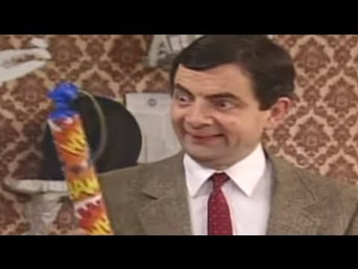
What could possibly go wrong?

Slide 10
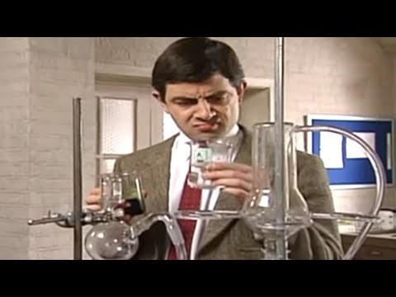
Mr. Bean gets educated.

Slide 11
How do we learn?

Slide 12
Our beliefs and prior learning matter.
Kids
Where do you think kids get most of their impressions about fire & life safety?
Adults
Where do you think adults get most of their impressions about fire & life safety?

Slide 13
Take a brief moment
Please recall a memorable learning experience from your past. It could be learning how to ride a bike as a child, or cook a particular meal or a work-related workshop you took – but choose one that stands out for you, personally.
Please identify the circumstance and in 1-2 sentences please try to explain why it was memorable. What made it so?

Slide 14
The research suggests
That we are most motivated to learn when our needs are met and we feel:
autonomous/independent
competent
a sense of belonging/relatedness

Slide 15
And also…
That we learn when are able to make connections to our own lives/experiences
When we feel it is of importance/value
When it is enjoyable, when we think we can.
When we want to grow.
By teaching others

Slide 16
Best practices
What practices have you seen/used in fire safety education (in schools or community) that support any of these?

Slide 17
It’s about a feeling. For you too!
If you are not genuinely moved, invested, curious, excited by what you are delivering – if it doesn’t give you goosebumps, make you excited, make you feel something, if you don’t clearly understand it or engage with it, etc. your audience will very likely not be interested either. How could you motivate yourself, re-design your lesson or collaborate differently to make it more authentic?

Slide 18
And that means we need to take extra care of ourselves and each other.
The topics you are dealing with can also be sensitive; in your role as an educator you have to be aware of the potential impact of your content and method of delivery -and feelings of your target audience (and have appropriate strategies and support in place).
This could be due to a ‘trigger’, past experience (e.g., consider the experience of a Syrian refugee student), a news item, or even a ‘tricky day’.
“Leave your problems at the door” is a myth for most of us.

Slide 19
Questions to consider.
How/why did you personally come have a career in fire and life safety?
What has kept you in it/motivated?
What is the biggest misconception or misunderstanding you feel people have about fire, safety and/or this industry?

Slide 20
Some of the things we see working in classrooms/ outreach…
Engagement is essential, and is the key to most classroom management (e.g. often linked to listening, behaviour, etc.)
Making connections with learning in other subject areas, prior knowledge, when possible.
Props/tools/equipment/artifacts/photos
Games, e.g. mystery, physicality, role play, obstacles, Escape Room style puzzles
Competition
Stories: personal, historical or about people the audience can relate to (their own age, celebrities, etc.)
Humour (film, cartoon/comic, etc.)
Different social dynamics: groups, individual, pair work (think/pair/share and Jigsaw), “speed dating” style,talking circles, non-teacher centred (i.e. give students “the floor”)…
Choices

Slide 21
Cont’d…
Incorporating technology/apps
Element of surprise, using the senses, building anticipation by setting the scene, etc.
Community/cross-curricular partnerships
Innovative locations, experiential learning
Extension activities and future challenges, leaving participants with great questions to think about
Prizes/giveaways
Food for community building! (when appropriate)
Adults often report that their most memorable learning experiences involve the arts, body or nature
Empowering someone with a role/title that indicates responsibility: “You are a Fire Safety Expert.”
It’s about building relationships and rapport

Slide 22
The Good News!
1) There is a natural awe, wonder and fascination with fire (even a possible ‘negative’ interest could turn into a positive one in a teachable moment).
2) There are many fantastic, good quality tools and lesson plans out there to assist your work already!
3) There is a large degree of respect in our society for people who work in these industries. Typically you will be presenting to a supportive and interested audience.

Slide 23
Directions in Teaching & Learning

Slide 24
1) Inclusive Language
Gender/preferred pronouns – it is becoming more common for students or teachers to identify their pronouns upfront
Political climate and recent changes to curriculum
Check out the work and wisdom of Dr. Lee Airton on respectful handling of issues related to gender/sexual diversity in the classroom https://educ.queensu.ca/lee-airton
Using more inclusive terminology in classrooms and community settings, i.e. rather than boys and girls or ladies and gentlemen, try “Grade 5s”, using first names, saying “Welcome, everyone!”
Sensitivities to family life, i.e. “moms” and “dads”, what is a ‘family’, heteronormative assumptions, etc.
Land acknowledgement, respectful of Indigenous histories
Respectful terminology around disability, accessibility, etc.

Slide 25
A+ in accessibility
Ableism: discrimination (in belief or practice) based on a person’s abilities, whether developmental, learning, physical, psychiatric or sensory. Ableism is a form of discrimination that devalues and disregards people with disabilities.
Access/Accessibility: is the creation of an environment where people, regardless of their abilities, can communicate clearly and participate actively.
(above definitions taken from http://www.chs.ca/glossary-terms)
AODA training https://accessontario.com/aoda/

Slide 26
Staff Room “Lingo”
Every industry (Education and Fire & Life Safety included!) has its own language/terminology that can be confusing for new colleagues or the general public.
While it can sometimes be helpful to use a shorthand or acronym (or occasionally even necessary to use industry-specific language), we should always consider the impact on our audience.
Can you think of some acronyms or terminology that I (or someone from the general public) might not understand in your industry?
Teachers traditionally love lingo, but sometimes it can unintentionally exclude students/parents, or the very members of the community we are trying to work with or serve.

Slide 27
Effective Communication in Teaching & Learning
Language matters in teaching &learning because:
It conveys energy, enthusiasm, information, meaning, understanding
Information can be of life or death importance in your field – include everyone in the conversation.
Different languages of our audience, including visual (ELL, ASL, etc.)
Different communication styles and literacy skills of facilitators, teachers and participants
Materials you are using– are they accessible? (e.g. subtitles on videos, handouts in multiple formats?)
It is constantly changing; new words, new medias, etc.
Non-verbal communication
Safety to ask questions. And answer them. The value of asking better questions: “Always the beautiful answer who asks a more beautiful question.” – ee cummings

Slide 28
2) Universal Design for Learning (UDL)
Borrowed from the world of architecture and design, this concept is based on the idea that when we make accommodations for certain kinds of learning needs and disabilities, these often end up improving the overall quality and experience for everyone.
Inclusivity
Multiple means of engagement, representation and action & expression (see handout, CAST 2018)
What is the difference between UDL and “differentiation”?

Slide 29
What is a UDL lesson plan?
A lesson plan is an outline of what you intend to achieve during an educational/outreach experience. It provides an overview of the information, resources and activities needed to organize an effective presentation or visit.
If you take a Universal Design for Learning approach you are including multiple means of engagement, representation and action & expression to reach all learners. The core belief is that learning should be accessible for all.

Slide 30
Let’s Review…
Basic Info (date, facilitator, location, # of participants)
Topic/ Learning Objectives/Focus Questions
Materials/Tools
Assessment/Success Criteria?
(Did they ‘get’ it?)
UDL Plans for beginning, middle and end with timing
Special Instructions (accommodations for learning, support staff, etc.)
Resources/Next Steps
Basic Lesson Template for Schools and Communities

Slide 31
What ingredients are essential for success?
Professionalism. In your industry, the information you present has to be accurate. If you make a mistake, you will take responsibility for it. Follow up with the necessary steps.
It includes multiple methods of instruction and engagement for all learners. It has to be inclusive in design, varied activity and use accessible language, i.e, everyone is involved and can learn.
It should be something you feel OK doing. If not take responsibility and speak to a supervisor to find solutions.
Good pacing – read your audience, and understand attention span/context. A strong beginning, middle and end.
Material has to be appropriate level for audience
Safety. It has to be considerate/compassionate and sensitive. Participants and staff need to feel ‘safe’.

Slide 32
Who/what is it for?
It is for instructors/facilitators to help them deliver with more comfort and ease.
It is for accountability and communication.
It designed to help maximize student learning.
It is to help focus content and delivery.
A lesson plan should be a working document. Something that is evolving and flexible and adaptable to different groups, contexts, facilitators, locations (e.g. one size does not fit all).

Slide 33
Why bother?
A set of guidelines to help you feel prepared/deliver a quality and inclusive experience for all (having a plan really helps!).
‘Walk your talk’ – i.e. if you’re encouraging others to be prepared, this is demonstrated in your approach and style through modelling.
Short time to make an impression and fit in a great deal of content. It helps with time management, especially during fast paced lessons/visits.
When you have all the ‘details’ sorted, it leaves more room for fun!
Public safety/education/awareness
Resources – opportunities for partnerships, grants/funding
Remember your own reasons and motivations for doing this work helps you be more intentional and purposeful.

Slide 34
In summary…
Your plan should include:
Accurate and up to date information
A learning goal/outcome
Inclusive and accessible activities
Appropriateness of content and lesson timing
Compassion and respect of boundaries
An opening ‘hook’/closing
Opportunities for ‘check-ins’/assessment
What makes it even better?

Slide 35
A collaborative approach
The creator/writer of lesson plan
Brings a wide range of tools/ideas/previous experience/philosophy/education and teaching experience
Must consider the unique nature of each context
Can assist with research and liaise with venue
Imbed choice and variety into plans, take a UDL approach
Must work alongside (consider needs of) teachers and learners
The facilitator(S)
Must contribute when possible – consistent feedback – how did this work?
Personalize when possible to help with comfort/motivation
If team-teaching, having clear roles and clearly communicating with partner – work to your strengths in lesson plan. Use it. Adapt as necessary.
Advocate for your ideas. Be willing to be flexible.

Slide 36
Collaboration continued…
the teacher/venue/hosts
Find out as much as you can beforehand. Be aware of instructions, prior knowledge, curriculum/learning expectations, their needs. Is this the ‘regular’ teacher?
Make use of teacher and support staff with clear plans for how you intend to include them embedded into the plan (but please discuss it with them!).
Risk assessment attached to plan (if required)
Ask for what you need! Room set up/ location/tech/supplies/curriculum
the students/participants
Finding ways to develop some success criteria together.
Volunteers/participation
Being sensitive to their individual needs (not everyone wants to get up and participate!). Consider this in your planning.
Allow room for choice, flexibility to linger on their interests, questions, natural curiosity
Student feedback or being involved in the design process?

Slide 37
What to do if things don’t go according to plan?
My equipment doesn’t show up or work.
Something is inaccurate in the plan/my delivery?
The location changes and impacts my plan.
There is a kid who just won’t stop talking!
The teacher leaves me alone in the classroom without any staff support and students are challenging me.
I forget the lesson plan.
I got the wrong lesson plan.
I’m embarrassed by the tasks in the lesson plan.
I didn’t have time to prepare a lesson plan.
The video won’t play.
The audience is laughing in places I didn’t want them to and isn’t taking me/this seriously.

Slide 38
3) Technology & Social Media
Working with these tools to enhance learning and improve engagement, accessibility, communication, global opportunities. games/apps, assistive technology, coding, etc.
New safety implications.
Sets a new standard for outreach materials
Research on attention span, multi-tasking

Slide 39
4) Stories. Lived experience.
Adult educators are guided to build upon and acknowledge learners’ previous life experience, skills, talents, and use those as a foundation for the lesson. Helps build connection/motivation.
Keep in mind with children and adolescents too. When possible, get a sense of what previous experience they’ve had with a topic.
Student-centered, celebratory, authentic learning.
You might try:
A pre-visit online questionnaire
A check-in when you arrive (e.g. ipad app/quiz) or more traditional approach (hands-up if you’ve ever…), etc.
Also, “who is at the table?” in program planning an important consideration for inclusivity and diversity. Recognizing which voices are not being heard.

Slide 40
5) Cross-Curricular/ Interdisciplinary
Combining two or more subjects
Arts-based approaches, STEM/STEAM, etc.
Experiential education
Outdoor/land-based education

Slide 41
Experiential Learning
Learning through experience, learning by ‘doing’
Experiential Learning Theory (ELT) (Kolb, 1984)
Traditionally, this has involved internships, job shadowing, etc. but definition continues to widen and be influenced by new cognitive research and technology (e.g., VR & empathy, medicine, BEAM robots, etc.)
Many Bachelor of Education programs are designed with this model in mind and also offer courses/research for Faculty and students, e.g. University of Saskatchewan, which has some very helpful resources: https://teaching.usask.ca/curriculum/experiential-learning.php#About
Key aspect is reflection ‘in doing’ – an embedded part of the process.

Slide 42
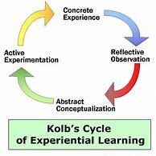
A four stage model
Resources:
Kolb, David A. 1984. Experiential Learning: Experience as the Source of Learning and Development. Prentice-Hall, Inc., Englewood Cliffs, N.J.
Kolb, D. A. (2014). Experiential learning: Experience as the source of learning and development. FT press.
Kolb, D. A. (2014). Experiential learning: Experience as the source of learning and development. FT press.

Slide 43
How are new technologies impacting experiential learning?
https://www.gapminder.org/dollar-street/about
https://www.suitabletech.com/
http://www.pirweb.org/en/vroc/
https://raffaello.name/dynamic-works/
Medical training
STEAM is an educational approach to learning that uses Science, Technology, Engineering, the Arts and Mathematics as access points for guiding student inquiry, dialogue, and critical thinking
VR and empathy (see The Power of Kindness by Brian Goldman)
How are new technologies impacting public education in your field?

Slide 44
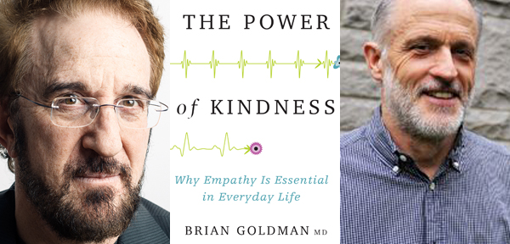

Slide 45
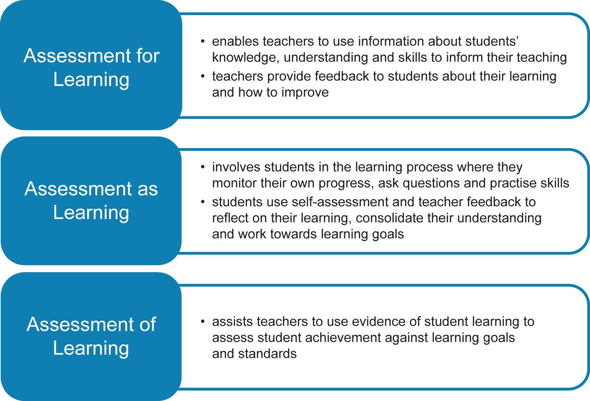
6) Assessment Image taken from UNESCO’s International Institute for Educational Planning portal

Slide 46
In your field assessment may look like…
Did they understand the information?
Will they be able to apply it?
How can I ensure that they will remember/use it in future?

Slide 47
7) Community Partnerships
Funding (grant opportunities, e.g. artists to collaborate with community organizations).
Shared responsibilities and resources
Do what you do best! Expertise.
Building connections to send a consistent message
A sense of community and relationship building
Anti-bullying initiatives
Libraries: coding, free visits, partnerships, etc.
community artist roster
a sense of giving back

Slide 48
8) Mental Health & Wellness
“Growth mindset”: We’re teaching children about neuroscience!
Ontario Wellbeing strategy
https://www.youtube.com/watch?v=J_io96tmTL8
Environmental wellness – community gardening programs, organic living, awareness of climate change, nature
Inter-generational programming
Meditation/yoga/self care (e.g. Wake Up Schools)
Respect for faiths, spirituality
Gratitude
Creating caring classrooms

Slide 49
If you only had a moment.
As a researcher, I have learned that sometimes we only get a few moments with someone, and it’s important to fit in one question that we find the most valuable or important. Sometimes learning happens informally or in one instant…
Big Money thought. What wisdom/tip/information would you pass along to someone in only a brief encounter?

